Slide 3
Developing modern business applications with Application Development Framework (ADF)
Logan Jensen, Technical Trainer
Greg Bousley, Instructional Designer

Slide 4
agenda
Alfresco Digital Business Platform
Application Development Framework
Building a Custom Application
Notes:
Here’s what we’ll be covering:
1. The Alfresco Digital Business Platform: We’ll explore the core components that drive digital transformation by managing and leveraging content effectively.
2. Application Development Framework (ADF): Learn how ADF empowers developers to create modern, responsive applications with reusable components.
3. Building a Custom Application: Finally, we’ll walk through how to build a tailored application that meets your specific business needs using ADF and the Alfresco platform.”

Slide 5
Alfresco Digital Platform

Slide 6
Alfresco Digital Business Platform
Application Development Framework
Integrations / Extensions
Open APIs and Open Standards
Alfresco Process Services
Alfresco Content Services
Alfresco Governance Services
Intelligence and Analytics
On-Prem, Cloud, Hybrid, Managed
Notes:
The Alfresco Digital Business Platform is an enterprise level, cloud native platform. It combines Content Services for centralized content storage and management, including robust document handling. Process Services enable the automation and enhancement of business processes, integrating seamlessly with other systems.

Slide 7
Application Development Framework

Slide 8
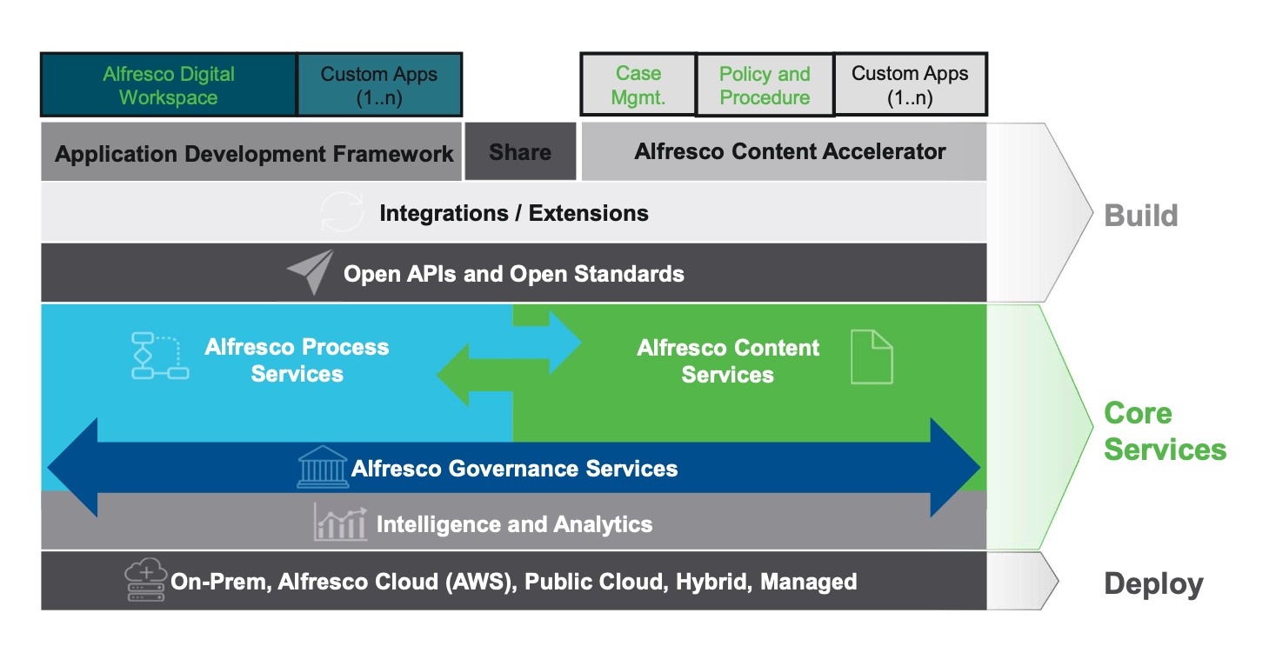
Application Development Framework
Notes:
Today, we’re exploring the benefits of the Alfresco Development Framework, or ADF. ADF empowers developers with a modern, Angular-based platform to rapidly build enterprise applications. It’s modular and customizable, which means you can tailor your solutions to meet specific business needs without starting from scratch. With pre-built components like content and process management, ADF accelerates development, reduces costs, and ensures a seamless integration with Alfresco services. Whether you’re improving collaboration or enhancing workflows, ADF offers the tools to innovate efficiently and effectively.

Slide 9
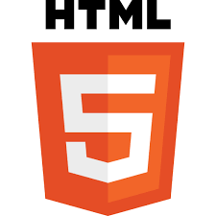
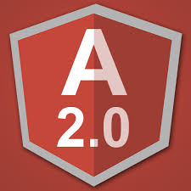
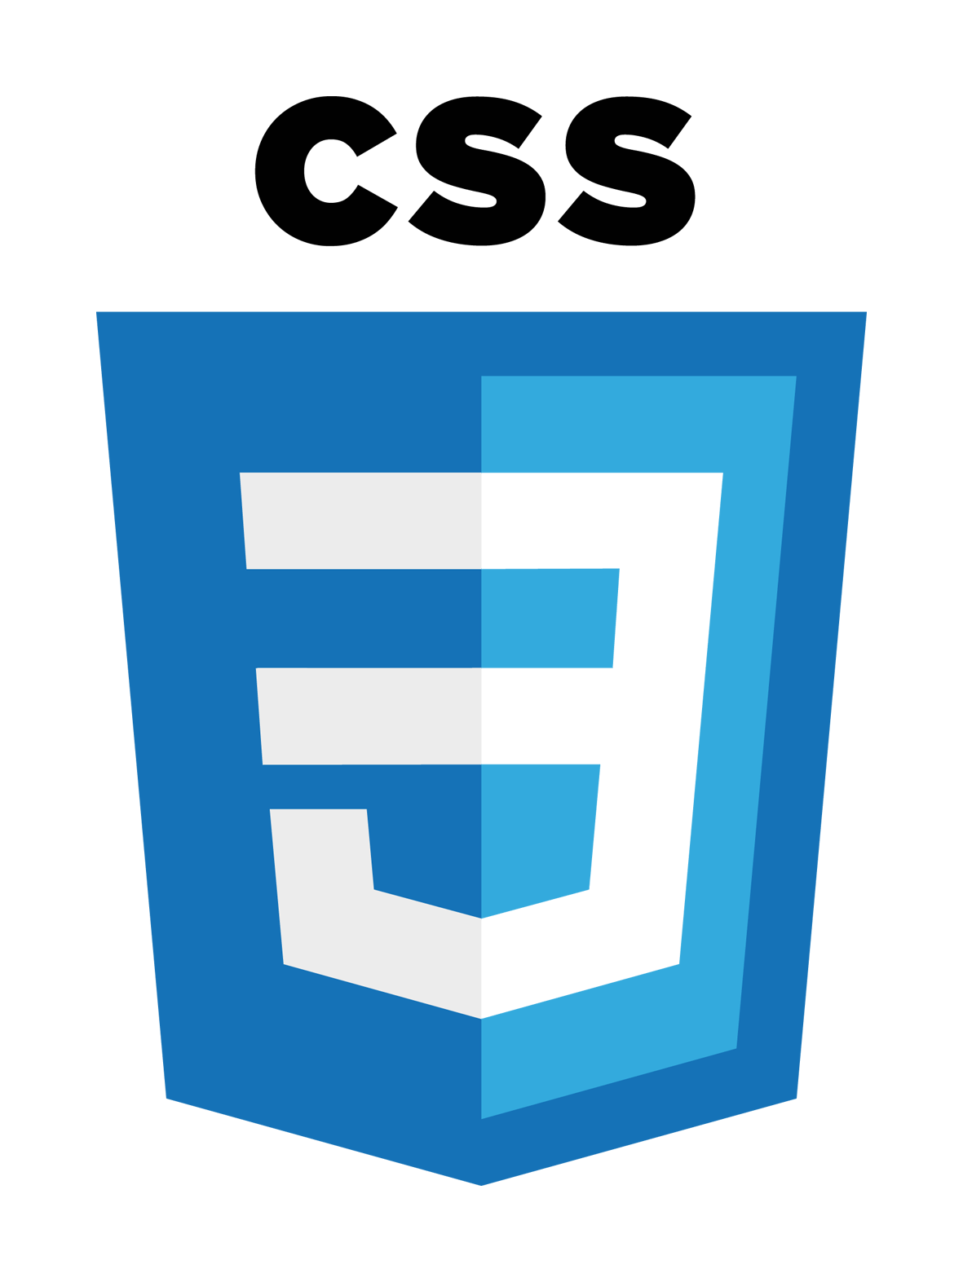
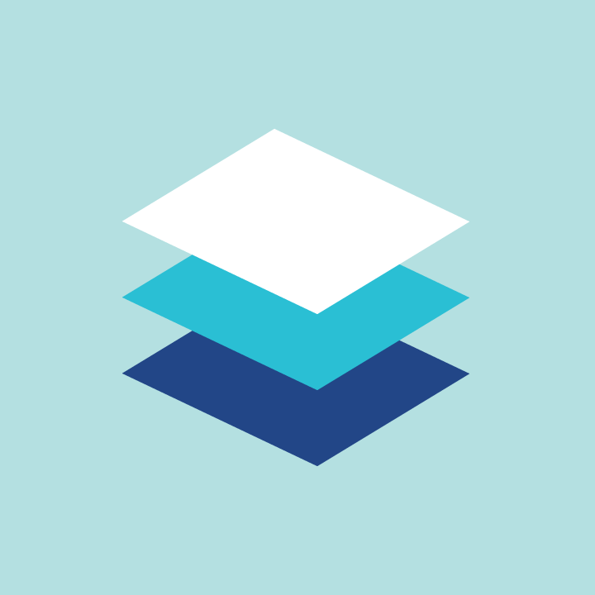


Framework Core Technologies
Languages
Frameworks
Development Tools
HTML5
Angular 14.x
Node
NPM
CSS
Angular Material 14.x
Yeoman
JavaScript
GitHub
Angular CLI
Typescript
Notes:
In this class we will be messing with 4 different programming language, HTML, CSS (Cascading Style Sheets), Java Script, and Typescript.
The application framework we will be using is Angular, which if you're not familiar with Angular, it is a development platform built on Typescript that is component based. We will talk about what components are later.
Then we have the Development tools we will be using.
Node- Open Source JS engine
Npm- package manager for JavaScript
Yeoman - a scaffolding generator that helps you quickly create the skeleton of a new application
Angular CLI - a command-line interface tool that you use to initialize, develop, scaffold, and maintain Angular applications directly from a command shell

Slide 10
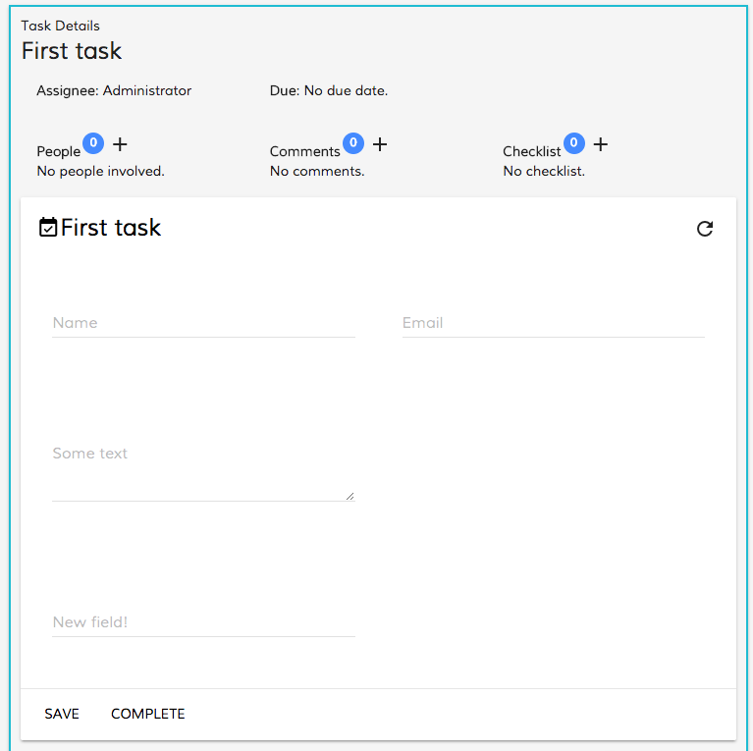
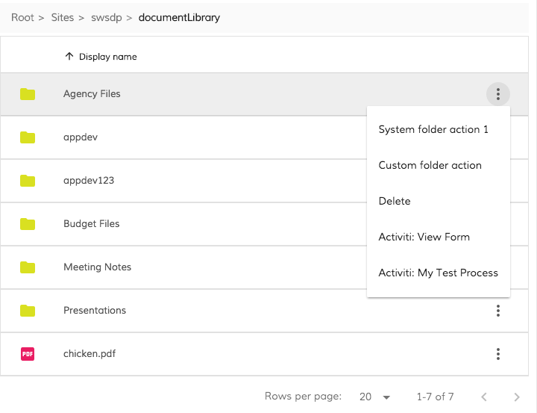
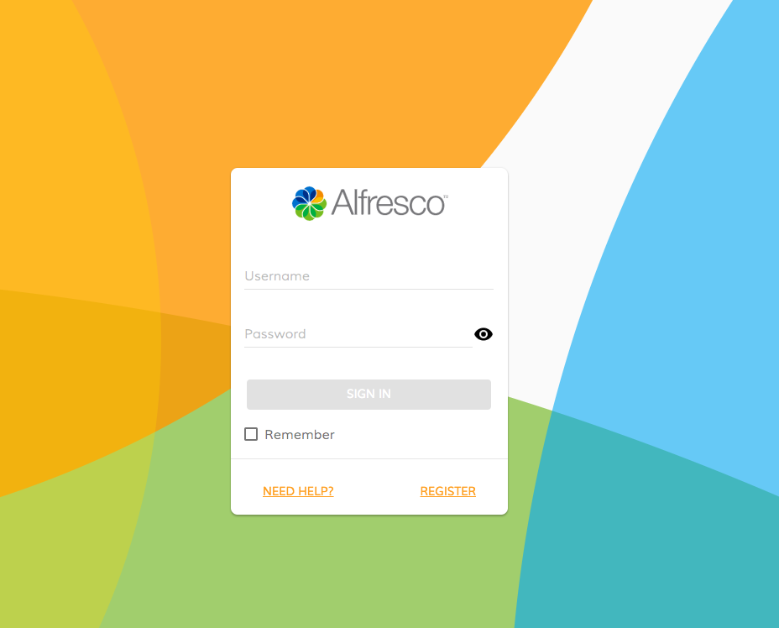
Design
Great design and user experience out of the box
Based on Google Material Design
Leveraging Google Material Design Lite
Research and validation driven design
Notes:
Material Design Lite (MDL) is a lightweight front-end framework that implements Google’s Material Design principles. It provides pre-built components like buttons, cards, and toolbars, which are styled according to Material Design guidelines. In Alfresco Development Framework (ADF), MDL is used to create responsive and consistent user interfaces. By integrating MDL, ADF ensures that the apps look modern and are easy to navigate, offering a cohesive design experience across different devices and screen sizes while reducing the need for custom styling.

Slide 11
Getting started
Access the workbook and files for class
Open VS Code
Add SSH config
Connect
REMEMBER YOUR USER NUMBER
Notes:
Let’s dive right in! We will be connecting to our ADP instance to get the files required for the class, then we will connect to our environment and start working on our apps!

Slide 12
Lab 1 Building an app for 9 Second Insurance
You’re a software engineer at 9 Second Insurance. Your task is to design a straightforward ADF application that seamlessly integrates both ACS repositories and APS processes into a unified platform. Additionally, the app should feature a company-branded launch screen where employees can log in.
Notes:
(Read Scenario) Today, we are going to use a Distributed Architecture approach to building our app. This method enhances scalability, security, and flexibility by dividing responsibilities between different servers, allowing them to be managed and scaled independently.

Slide 13
Lab 2 Enhancing the ADF App with Document Search
Now that the ADF app is up and running, your next task is to implement a feature that allows users to search for documents within the ACS repository. The search results should also display the type of document and the user who originally uploaded it.
Notes:
(Read Scenario)

Slide 14
ADF Components

Slide 15
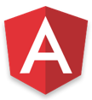
ADF Components
Form Component
Tasks Component
Process Component
Upload Component
Document List Component
Card View Component
Webscript Component
Search Component
Login Component
Data Table Component
Viewer Component
Info Drawer
Common components
Process components
Angular
Content components
Notes:
What makes ADF easy is the fact that there are over 150 available premade components. In Angular, a component is a fundamental building block that encapsulates the behavior, presentation, and structure of a part of a user interface.
We will be interacting with several in the class including Login, Search, Upload, Document List, and a card view component.

Slide 16
Creating a Component
View - HTML
Controller - Typescript
Service – Javascript / Typescript
Notes:
In an Alfresco Development Framework (ADF) component, the structure is similar to that of Angular components, where you would typically have:
View (HTML file): Handles the UI layout and presentation logic. This is where you’d define how your component looks using Angular templates.
Controller (TypeScript file): Contains the business logic for the component. It manages data flow between the view and model.
Service (TypeScript file): Handles data communication, often interacting with APIs or back-end services. It keeps the component logic clean and reusable.
For an ADF component, these files would be located in a specific directory corresponding to your component and would follow Angular’s conventions. The view is in the .html file, the controller is in the .ts file, and services would typically be in separate .ts files under a services directory.

Slide 17
Lab 3 Integrating Analytics into the ADF Application
Your ADF application is performing well in production, providing users with a streamlined experience for finding documents and initiating claims processes. The next step is to integrate your analytics site into the application, enabling the tracking of task durations. This data will be crucial for optimizing the processes later.
Notes:
(Read Scenario)

Slide 18
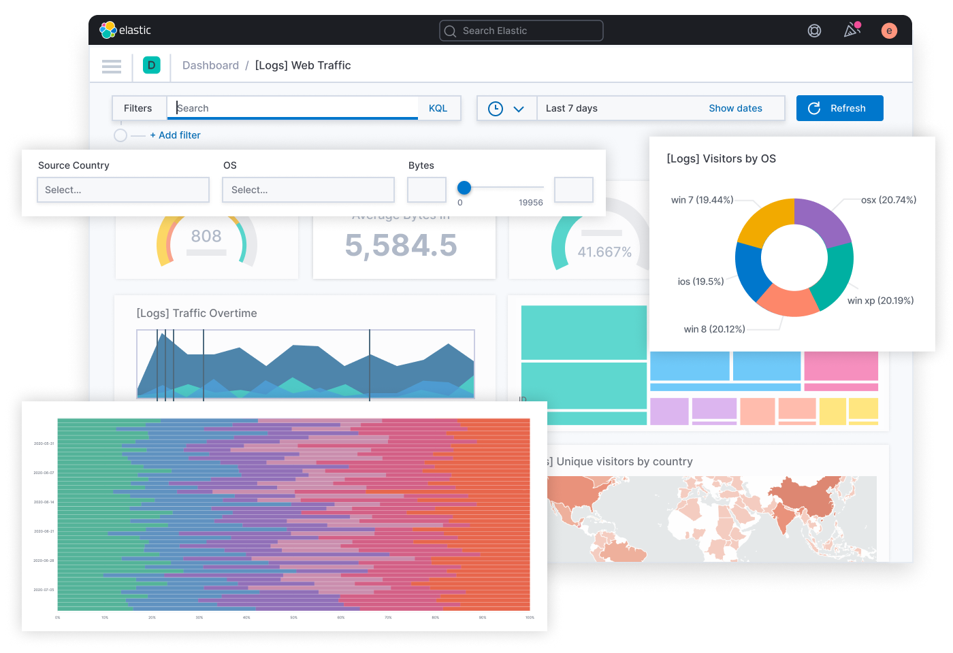
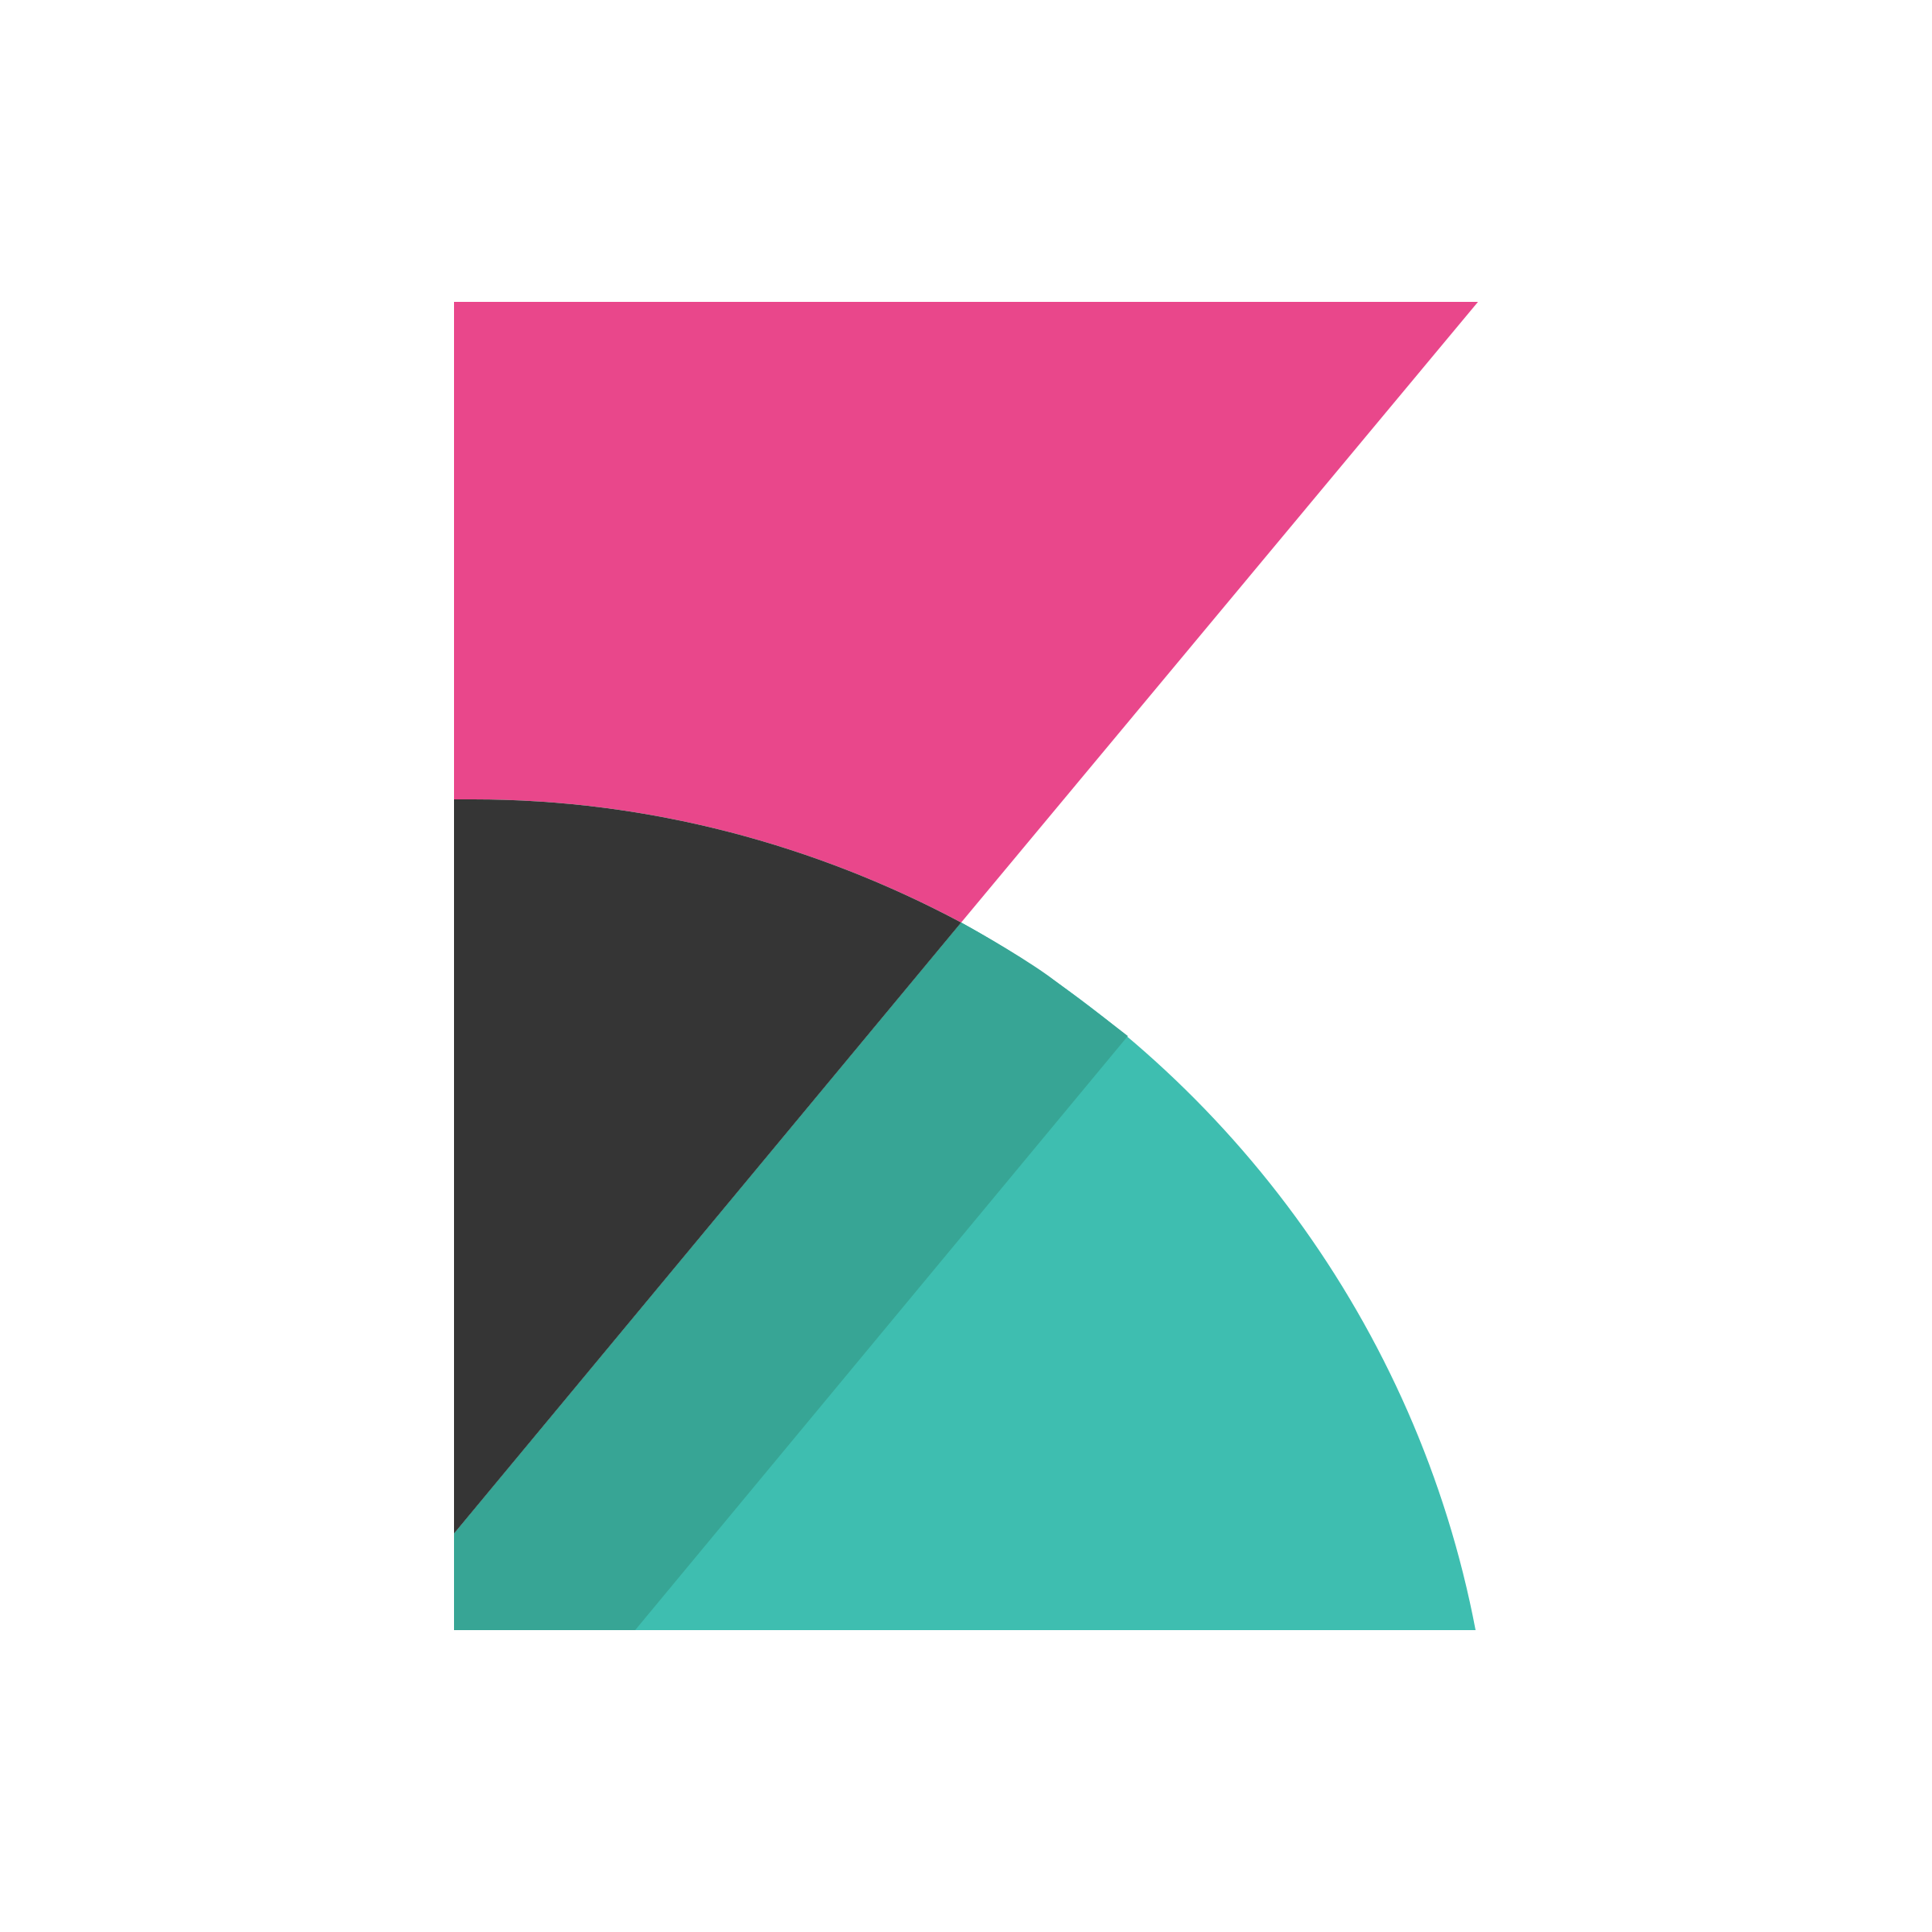
Kibana
Notes:
Kibana is an open-source data visualization and exploration tool primarily used with Elasticsearch. It allows users to create visualizations, dashboards, and reports based on large volumes of data stored in Elasticsearch indices. Kibana provides powerful capabilities for search, analysis, and monitoring of data, making it a popular choice for log and event data analysis, application performance monitoring, and security analytics. Its intuitive interface helps users create and share visual insights without requiring deep technical expertise. We won't be using it much in this class. This is just the analytics tool that we will be linking our ADF app to.

Slide 19
Thank you! Logan Jensen, Technical Trainer

Slide 20
Thank you!

